Slide 1
Math Co-processor
Reference: BREY

Slide 2
Intel Processors & Co-processors
Processor | Corresponding Co-processor
8086/8088 | 8087
80186/80188 | 80187
80286 | 80287
80386 | 80387SX, 80387DX
80486SX | 80487SX
80486DX and above | Built-in

Slide 3
Math Co-processor
Intel family of math coprocessor are generally labelled as 80x87
Instruction sets and programming of all devices are almost identical

Slide 4
Math Co-processor (cont...)
Intel family of coprocessors is able to
  add
  subtract
  multiply
  divide
  find square root
  calculate partial tangent
  calculate partial arctangent
  logarithms
Data types include
  16-, 32- and 64-bit signed Integers
  18-digit BCD
  32-, 64- and 80-bit floating point numbers

Slide 5
Math Co-processor (cont...)
The operations performed by 80x87 generally execute many times faster than equivalent operations written with the most efficient programs that use processors normal instruction set

Slide 6
Math Co-processor (cont...)
Data Formats
Data types include
  16-, 32- and 64-bit signed Integers
  18-digit BCD
  32-, 64- and 80-bit floating point numbers
Follow IEEE 754 standard
  Different from Microsoft or ANSI floating point standard

Slide 7
Math Co-processor (cont...) signed Integers
bit | range
16 | -32,768 to +32,767 | word | DW
32 | -2 x 10⁹ to +2 x 10⁹ | double word/ short integer | DD
64 | -9 x 10¹⁸ to +9 x 10¹⁸ | long integer | DQ
Positive numbers are stored in true form with a leftmost bit 0
Negative numbers are stored in 2's complement form with leftmost bit 1

Slide 8
Math Co-processor (cont...)
BCD
Requires 80 bits (10 bytes) of memory
Number is stored as 18-digit packed integer in 9 bytes as two digits per byte
10th byte contains the sign in MSB bit
Both positive and negative numbers are stored in true forms
  Never in any complement form

Slide 9
Math Co-processor (cont...) floating point numbers
Also known as real number
Has three parts:
  A sign bit
  A biased exponent
  A significand
Significand is treated as 1.xxxxx
sign
exponent
Significand as xxxxx
•

Slide 10
Math Co-processor (cont...) floating point numbers (cont...)
Intel co processors support three types of floating point numbers:
  Short/single precision 32 bits 1+8+23
    Exponent bias 7F (127 decimal)
  Long/double precision 64 bits 1+11+52
    Exponent bias 3FF (1023 decimal)
  Temporary/extended precision 80 bits 1+15+64
    Exponent bias 3FFF (16383 decimal)

Slide 11
Math Co-processor (cont...) floating point numbers (cont...)
How to convert to floating point form
  Convert the decimal number to binary
  Normalize the binary number
  Calculate the biased exponent
  Express the number in the floating point format
6.625
1. 110.101
2. 1.10101 X 2²
3.10+0111111=10000001
4. sign=0
exponent=10000001
fraction=101010....0
Example: Represent 6.625 in single-precision (32 bit) floating-point format

Slide 12
Math Co-processor (cont...) floating point numbers (cont...)
How to convert from floating point form
1. Separate the sign-bit, biased exponent and fraction
2. Calculate the true exponent
    true exponent = biased exponent – bias
3. Write the number as normalised binary number
4. Convert it to de-normalized number
5. Convert the de-normalized number to its decimal value

Slide 13
Math Co-processor (cont...) floating point numbers (cont...)
convert 11000001110010010...0 to decimal value
1. sign bit = 1, biased exponent = 10000011
fraction = 10010010...0
2. biased exponent = 10000011
bias = 01111111
true exponent = 00000100
3. normalized binary number = 1. 10010010...0 x 2⁴
4. de-normalized number = 11001.001
5. decimal value = -25.125

Slide 14
Math Co-processor (cont...) floating point special numbers
    Sign bit exponent significand/mantissa
±0 0/1 0...0 0...0
±∞ 0/11...1 0...0
NAN d 1...1 not all zeros
(not a number)

Slide 15
Math Co-processor (cont...) storing floating point numbers in memory
Single precision DD/Real4
Double precision DQ/Real8
Extended precision DT/Real10

Slide 16
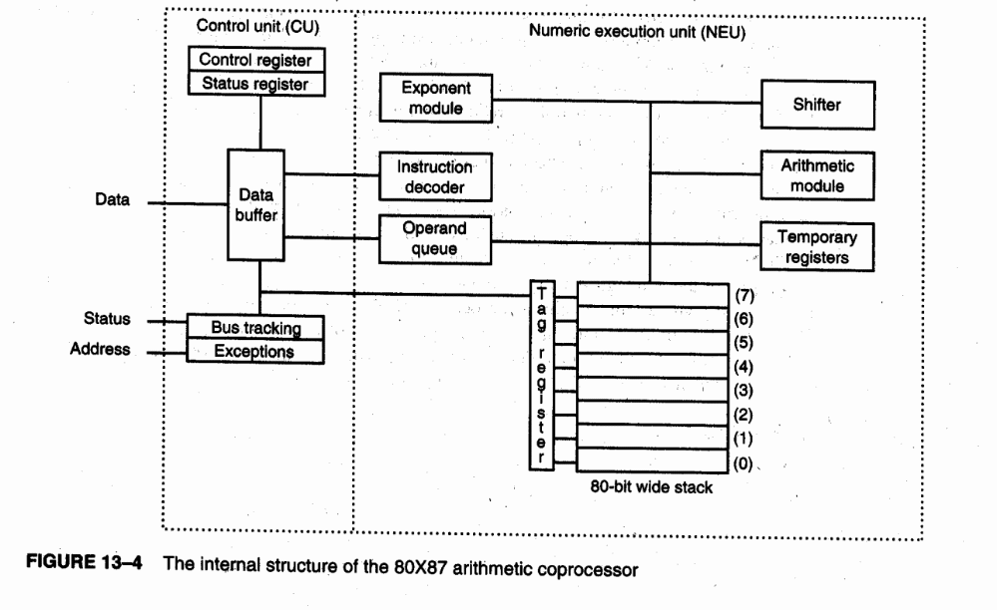
Internal Architecture

Slide 17
Internal Architecture (cont...)
Arithmetic co-processor is divided into two major sections:
  the control unit (CU) and
  the numeric execution unit (NEU)

Slide 18
Control Unit (CU)
The CU interfaces the co-processor to the microprocessor system data bus.
Both of the devices (Processor and Coprocessor) monitor the instruction streams.
If the instruction is an co-processor instruction, the coprocessor executes it;
If not, the microprocessor executes it.

Slide 19
Numeric Execution Unit (NEU)
The NEU is responsible for executing all co-processor instructions.
The NEU has an eight-register stack that holds operands for arithmetic instructions and the results of arithmetic instructions.
Instructions either address data in specific stack data registers or use a push and pop mechanism to store and retrieve data on the top of the stack.

Slide 20
Numeric Execution Unit (NEU) (cont...)
Other registers in the NEU are
  Status,
  control,
  tag, and
  exception pointers.

Slide 21
Numeric Execution Unit (NEU) (cont...)
A few instructions transfer data between the co-processor and the AX register in the microprocessor.
The FSTSW AX instruction is the only instruction available to the co-processor that allows direct communications to the microprocessor through the AX register.
Note that the 8087 does not contain the FSTSW AX instruction.

Slide 22
Numeric Execution Unit (NEU) (cont...)
The stack within the co-processor contains eight registers that are each 80-bits wide.
These stack registers always contain an 80-bit extended precision floating-point number.
The only time data appear as any other form is when they reside in the memory system.
The co-processor converts from signed integer, BCD, single-precision, or double-precision form as the data are moved between the memory and the co-processor register stack.

Slide 23
Status Register
The status register reflects the overall operation of the co-processor.
The status register is accessed by executing the instruction (FSTSW), which stores the contents of the status register into a word of memory.
The FSTSW AX instruction copies the status register directly to the microprocessor's AX register on the 80287 or above co-processor

Slide 24
Status Register (cont...)
Once status is stored in memory or the AX register, the bit positions of the status register can be examined by normal software.
The co-processor/microprocessor communications are carried out through the I/O ports 00FAH-00FFH on the 80287 and I/O ports 800000FAH-800000FFH on the 80386 through the Pentium Pro.
Never use these I/O ports for interfacing I/O devices to the microprocessor.

Slide 25
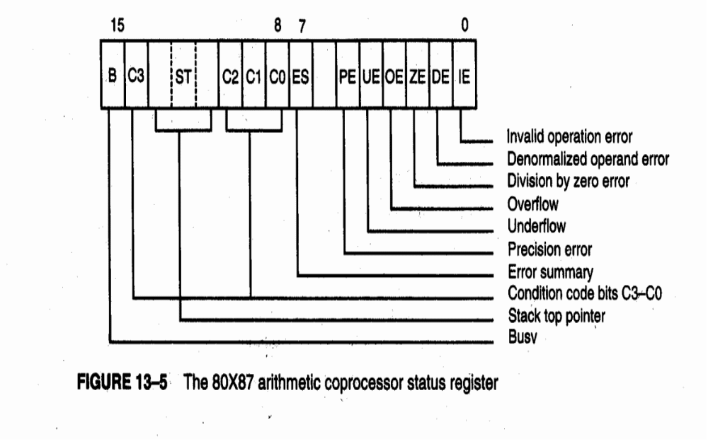
Status Register (cont...)

Slide 26
Status Register (cont...)
IE Invalid Error
  An invalid error indicates a stack overflow or underflow, indeterminate form (0/0, 0, -0, etc.), or the use of a NAN as an operand.
  This flag indicates errors such as those produced by taking the square root of a negative number, etc.

Slide 27
Status Register (cont...)
DE Denormalised Operand Error
  A denormalized error indicates at least one of the operands is denormalized.
ZE Division by Zero Error
  A zero error indicates the divisor was zero while the dividend is a non-infinity or non-zero number.

Slide 28
Status Register (cont...)
OE Overflow Error
  An overflow error indicates a result that is too large to be represented.
  If this error is masked, the co processor generates infinity for an overflow error.
UE Under-flow Error
  An under-flow error indicates a non-zero result that is too small to represent with the current precision selected by the control word.
PE Precision Error
  The precision error indicates that the result or operands exceed selected precision.

Slide 29
Status Register (cont...)
ES Error Summary
  The error summary bit is set if any unmasked error bit (PE, UE, OE, ZE, DE, or IE) is set.
  In the 8087 co processor, the error summary also caused a co processor interrupt.
  Since the 80287, the co processor interrupt has been absent from the family.
ST stack top pointer
  This bit indicates the current register addressed as the top-of- the-stack (ST).
  This is normally register 0.

Slide 30
Status Register (cont...)
C3-CO
  The condition code bits indicate conditions about the co processor (refer to Table 14-2 for a complete listing of each combination of these bits and their functions).
  Note that these bits have different meanings for different instructions, as indicated in the table.
  The top of the stack is denoted as ST in this table.

Slide 31
Status Register (cont...)
The 80X87 status register condition code bits
Instruction C3 C2 C1 CO Indication
FTST. FCOM 0 0 X 0 ST > Operand 0 0 X 1 ST < Operand 1 0 X 1 ST = Operand
1 1 X 1 ST is not comparable FPREM Q1 0 QO Q2 Rightmost 3-bits of quotient
? 1 ? ? Incomplete FXAM 0 0 0 0 + unnormal 0 0 0 1 + NAN
0 0 1 0 -unnormal 0 0 1 1 -NAN
0 1 0 0 + normal 0 1 0 1 +00
0 1 1 0 -normal 0 1 1 1 -00 I ' ,.
.1 0 0 0 +0
.f 1 0 0 1 Empty .1 0 1 0 -0
1 0 1 1 Empty 1 1 0 0 + denormal
1 1 0 1 Empty
1 1 1 0 -denormal
1 1 1 1 Empty

Slide 32
Status Register (cont...)
The 80X87 status register condition code bits
Instruction C3 C2 C1 CO Indication
Notes: Unnormal = leading bits of the significand are zero; denormal = exponent at its most negative value; normal = standard floating-point form; NAN (not-a-number) = an exponent of all ones and a significand not equal to zero and the operand for FTST is zero.

Slide 33
Status Register (cont...)
B Busy bit
  The busy bit indicates that the coprocessor is busy executing a task.
  Busy can be tested by examining the status register or by using the FWAIT instruction.
  Newer coprocessors automatically synchronize with the microprocessor, so the busy flag need not be tested before performing additional coprocessor tasks.

Slide 34
Control Register
The control register is pictured in next slide
The control register selects precision, rounding control, and infinity control.
It also masks and unmasks the exception bits that correspond to the rightmost six bits of the status register.
The FLDCW instruction is used to load a value into the control register.

Slide 35
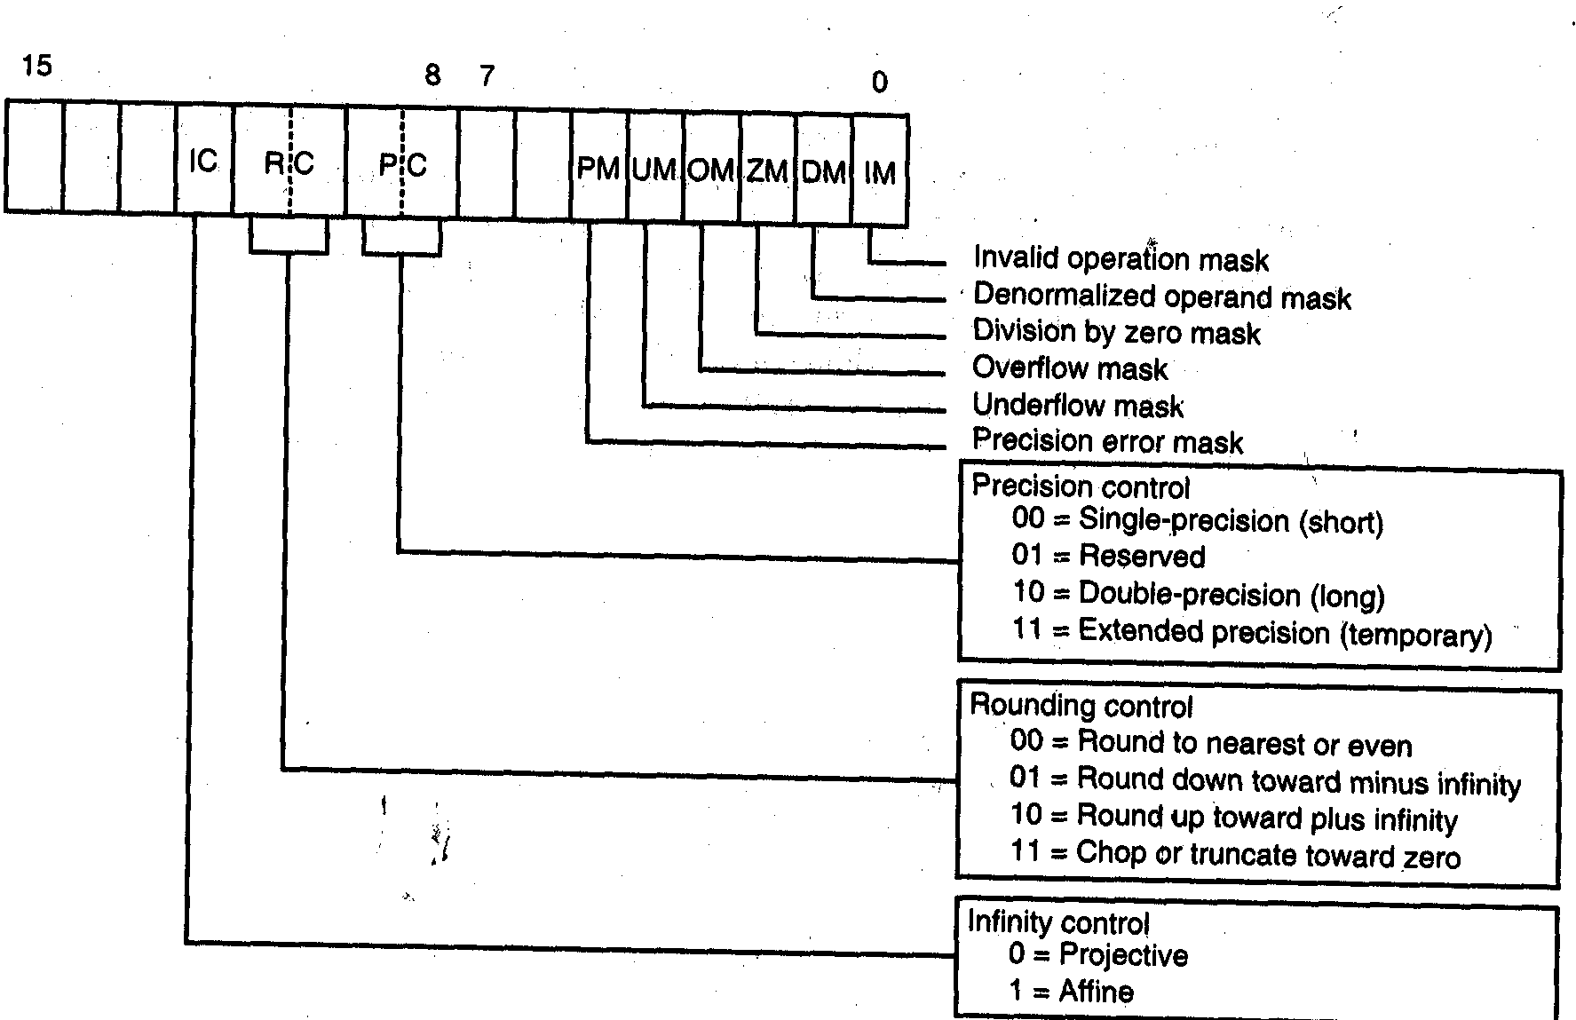
Control Register (cont…)

Slide 36
Description of control bits
IC Infinity control
  selects either affine or projective infinity.
    Affine allows positive and negative infinity, while
    projective assumes infinity is unsigned.
RC Rounding control
  determines the type of rounding as defined in previous slide
PC The precision control
  sets the precision of the result as defined in previous slide
Exception Masks (PM, UM, OM, ZM, DM, IM)
  Determine whether the error indicated by the exception affects the error bit in the status register.
  If a logic I is placed in one of the exception control bits, the corresponding status register bit is masked off.

Slide 37
Tag Register
The tag register indicates the contents of each location in the coprocessor stack.
Next slide illustrates the tag register and the status indicated by each tag.
The tag indicates whether a register is valid, zero, invalid or infinity, or empty.
The only way that a program can view the tag register is by storing the coprocessor environment using the FSTENV, FSA VE, or FRSTOR instructions.
Each of these instructions stores the tag register along with other co-processor data.

Slide 38
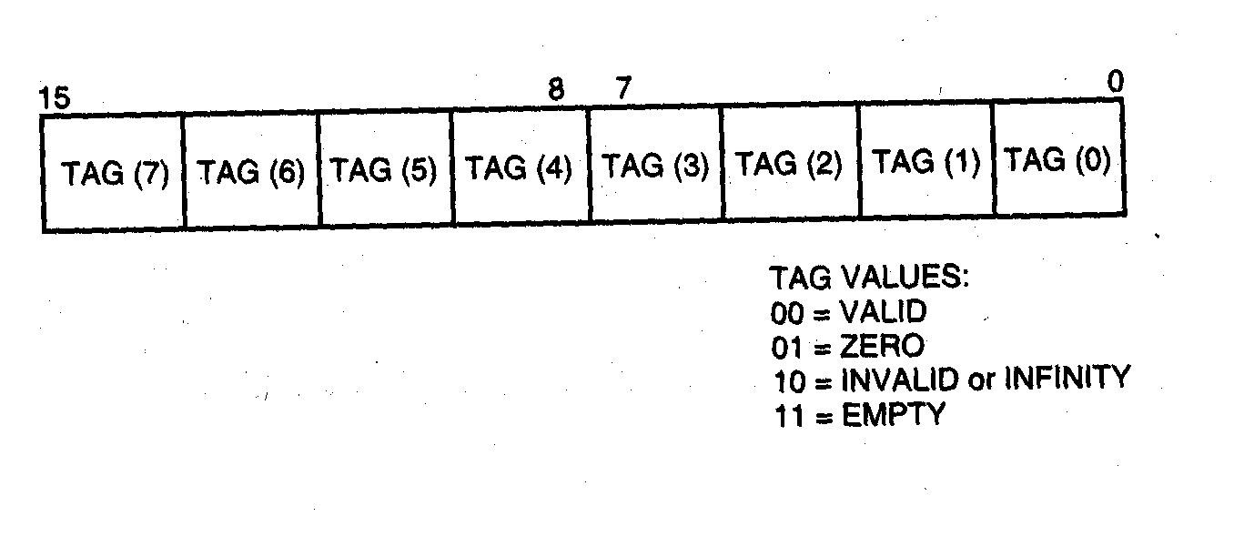
Tag Register (cont…)

Slide 39
Co processor Instruction Set
The 80x87 is designed to operate concurrently with the microprocessor
The microprocessor executes all normal instructions, and the 80x87 executes arithmetic co-processor instructions
The 80x87 executes 68 different instructions
WE WILL NOT STUDY INSTRUCTIONS

Slide 40
That’s All

